Slide 1
Exchange User Group {Online Edition}
11. Februar 2021

Slide 2
Meetup 2021-02-11
Talk 1 - Microsoft Teams mit Exchange Server On-Premises Ralf Leistner
Talk 2 - Real-life security and developer tips for MS Graph and Exchange Online you should be aware of Ingo Gegenwarth

Slide 3
Exchange User Group

Slide 4

Exchange User Group
Organisatorisches
Homepage: https://exusg.de
Twitter: @exusg #exusg

Slide 5
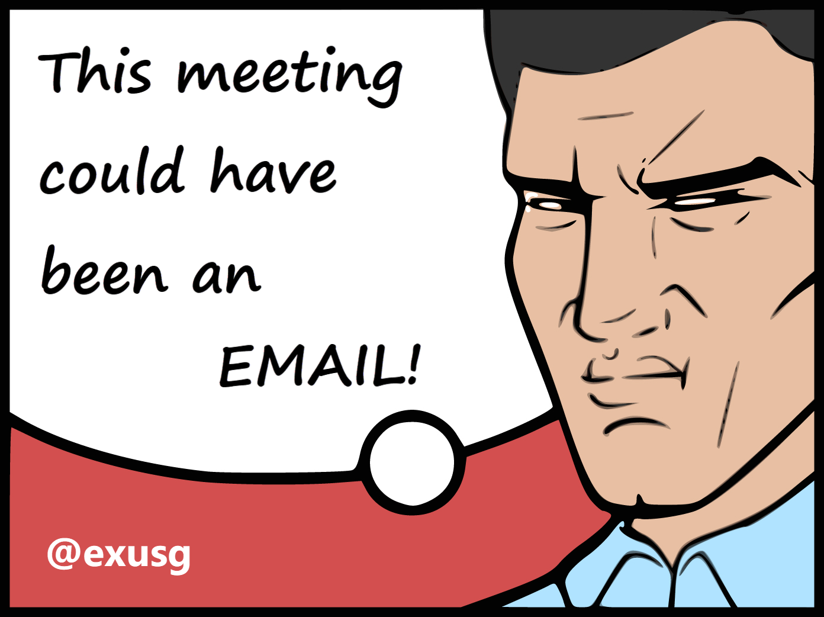
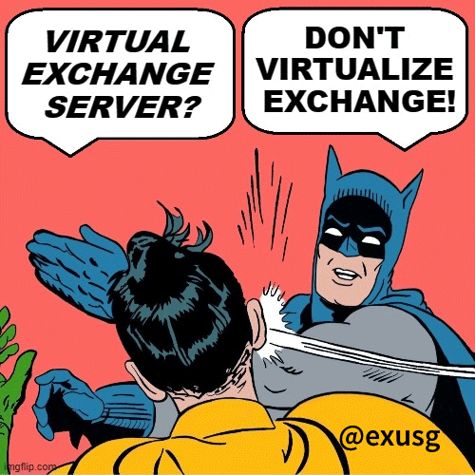
Exchange User Group
Organisatorisches
Exchange User Group Team
Im Microsoft Community Tenant
Community Sticker
https://go.granikos.eu/CommunitySticker
EXUSG-Logo Sticker in Kürze verfügbar
Sticker-Contest
Exchange Floskeln und Texte per DM an @exusg

